Slide 1

AUTOMATED FILE ORGANIZER

Slide 2

Objective of this Code :
A Python Code used to mange junk objects or files in a folder.It can be used by running the Code in a given folder and it will automatically move all files to the corresponding folder.
Example:
Move all Audio files into the Audio folder.

Slide 3

Modules used in this Code :
PYTHON OS MODULE
PYTHON SHUTIL MODULE

Slide 4
PYTHON OS MODULE:
The OS Module in Python provides Functions for interacting with the operating system .OS comes under the Python’s standard utility modules.
FUNCTIONS OF OS MODULE:
Handling the Current Working Directory
Creating a Directory
Listing out Files and Directories with Python
Deleting Directory or Files using Python

Slide 5
PYTHON SHUTIL MODULE:
Python Shutil Module provides the facility to perform the high-level file operation. It can operate with the object and offers us the ability of copy and remove the files. It handles the low-level semantic such creating and closing file objects after performing all operations
FUNCTIONS OF OS MODULE:
Coping Files and Directories
Moving Files and Directories
Renaming Files and Directories
Deleting Files and Directories

Slide 6
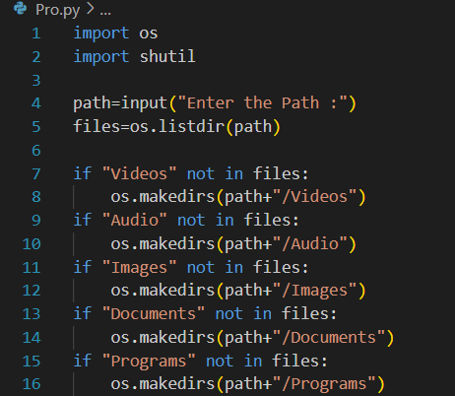
Importing the Modules
Get the Path Destination and Access the Path
Creating a separate folder to move the Corresponding files

Slide 7
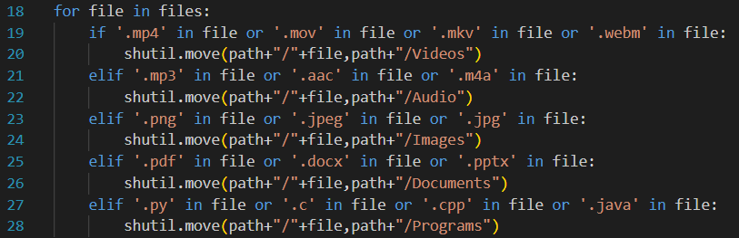
Move the junk objects into the appropriate folder by its format type

Slide 8
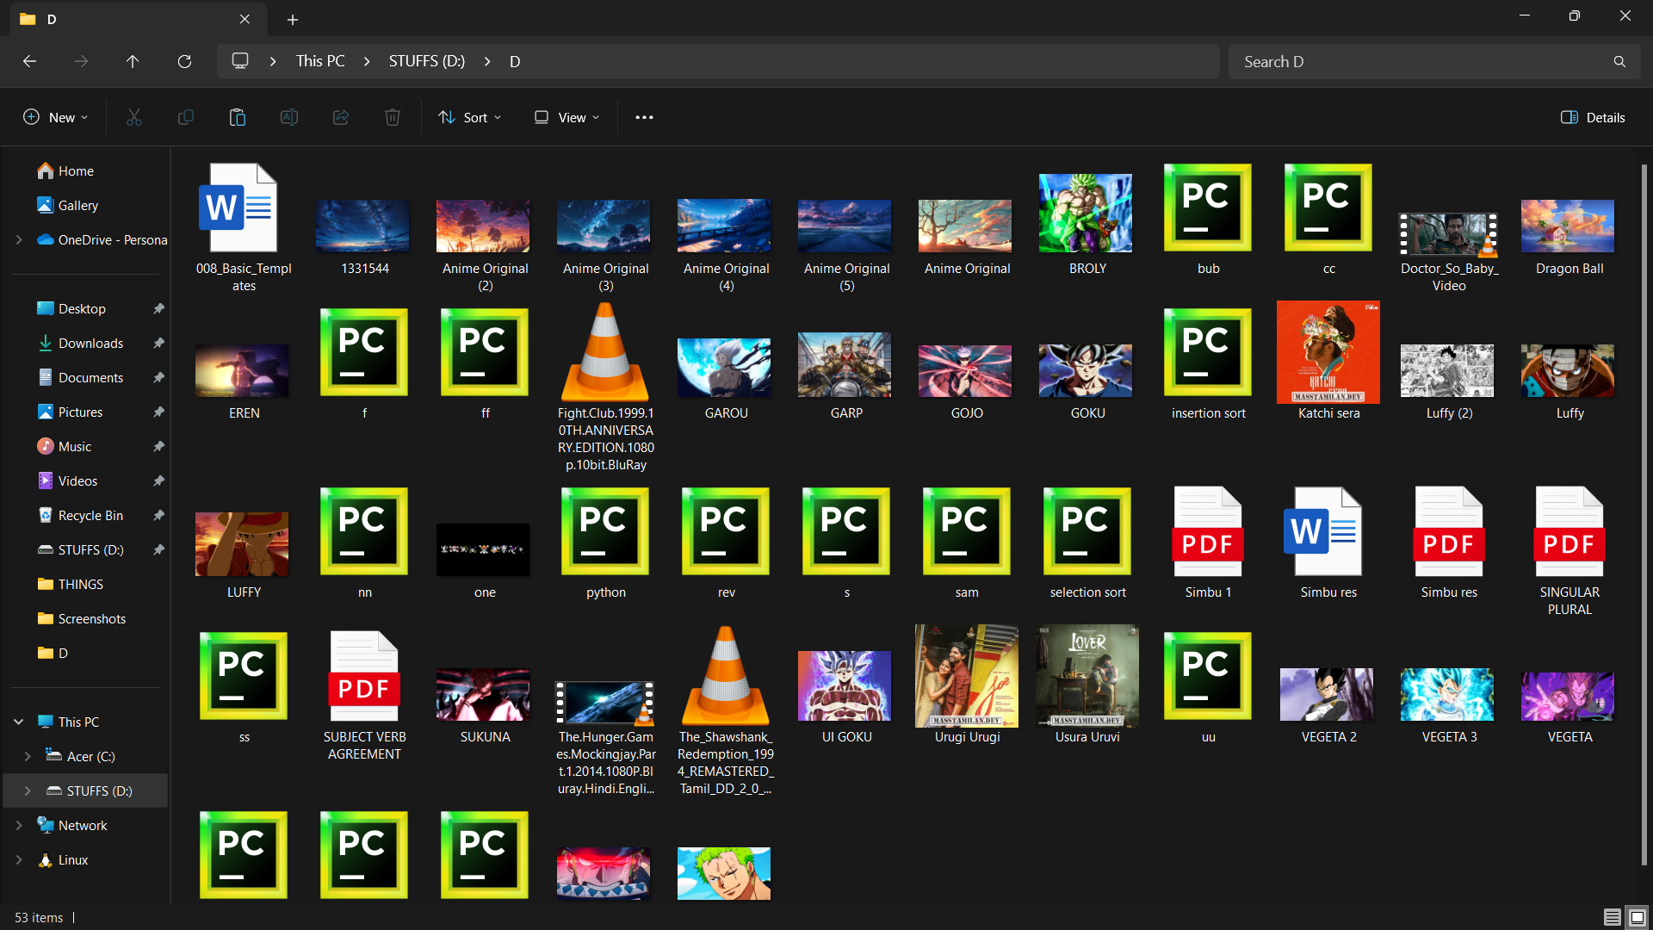
OUTPUT:
Before File Organize

Slide 9
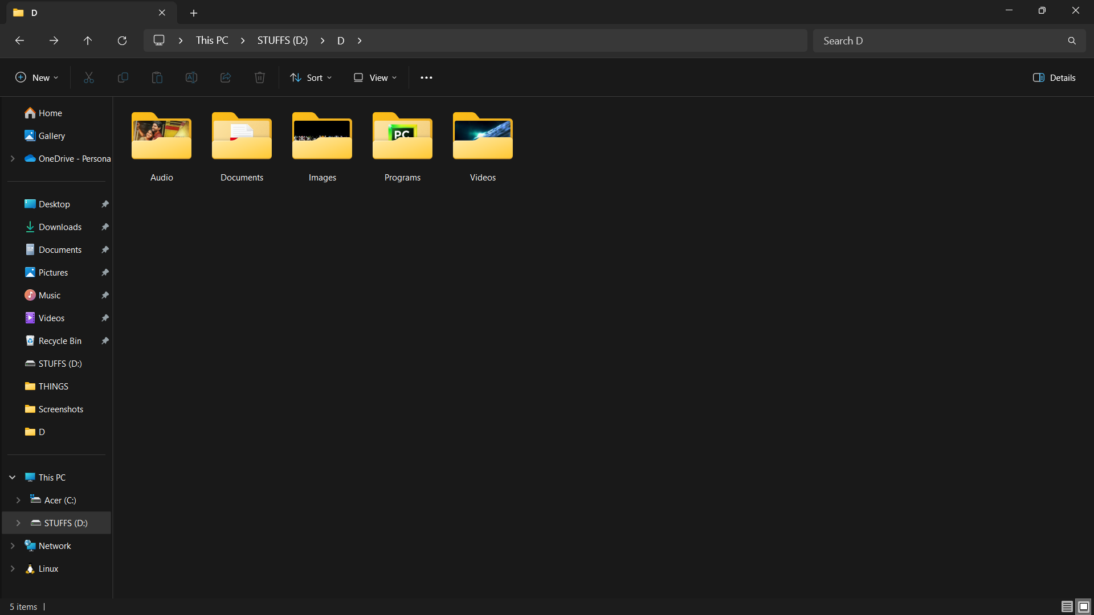
OUTPUT:
After File Organize

Slide 10
THANK YOU

